Slide 1
Python week 2
Canberra Chinese School Sem3

Slide 2

New topic: list comprehension
Fibonacci sequence is a sequence that starts with 0 and 1, and each term after is the sum of the two preceding terms.
It looks like this:
0, 1, 1, 2, 3, 5, 8, 13, 21, 34, 55…

Slide 3
New topic: list comprehension
Challenge: write a script that creates a list containing the first 100 terms (at least) of the Fibonacci sequence
The list should look like this:
0, 1, 1, 2, 3, 5, 8, 13, 21, 34, 55… all the way to really really large numbers

Slide 4
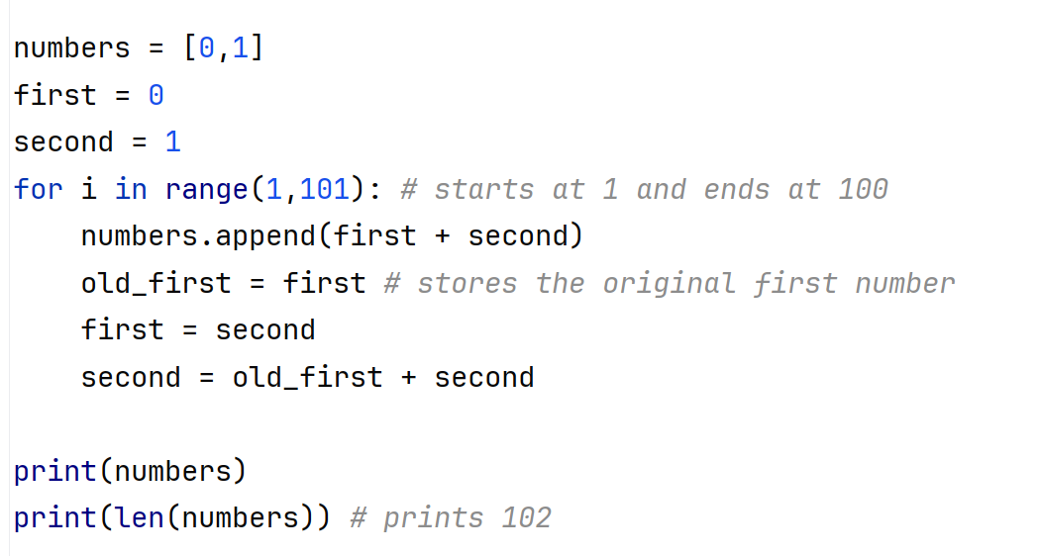
New topic: list comprehension
Challenge: write a script that creates a list containing the first 100 terms (at least) of the Fibonacci sequence

Slide 5
New topic: list comprehension
Let’s move on to actual list comprehension.
There’s a much shorter way to create these lists.

Slide 6
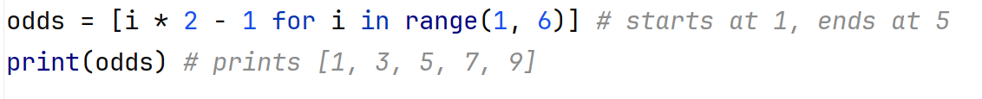
New topic: list comprehension
Let’s move on to actual list comprehension.
There’s a much shorter way to create these lists.

Slide 7
New topic: list comprehension
Let’s move on to actual list comprehension.
There’s a much shorter way to create these lists.
However, this shorter method would not be flexible enough to create the first 100 terms of the Fibonacci sequence that we created.

Slide 8
New topic: list comprehension
The general structure of list comprehension is:
new_list = [expression for item in old_list]

Slide 9
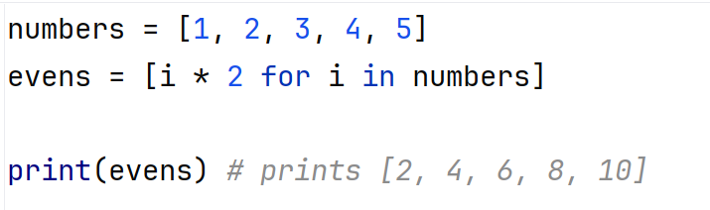
New topic: list comprehension
The general structure of list comprehension is:
new_list = [expression for item in old_list]
Example:

Slide 10
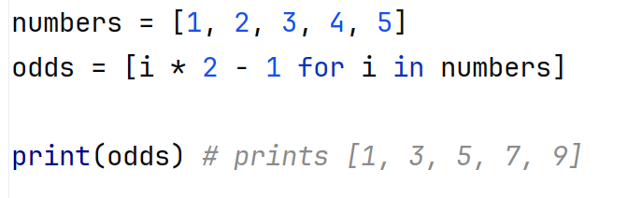
New topic: list comprehension
The general structure of list comprehension is:
new_list = [expression for item in old_list]
Example:

Slide 11
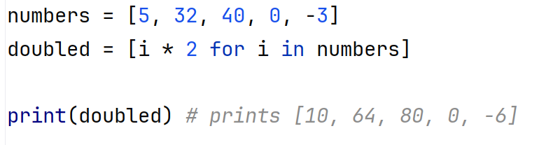
New topic: list comprehension
Some more examples:

